Slide 1
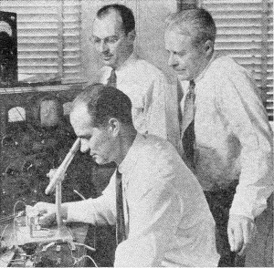
A bit of history
The first transistors were fabricated in 1947 at Bell Laboratories (Bell Labs) by Brattain with Bardeen providing the theoretical background and Shockley managed the activity.
The trio received a Nobel Prize in Physics for their work in 1956.
The transistor was called a
point-contact transistor and was
a type of bipolar junction transistor (BJT).

Slide 2
A bit more history
The theory on field effect transistors (FETs) was developed much earlier than our understanding of BJTs
First patent on FETs dates from 1925
Julius Edgar Lilienfeld, an Austro-Hungarian physicist
However, the quality of the semiconductor and the oxide materials were barriers to developing good working devices.
The first FET was not invented until 1959
Dawon Kahng and Martin M. (John) Atalla of Bell Labs

Slide 3
Integrated Circuits
Integrated circuits (ICs) are chips, pieces of semiconductor material, that contain all of the transistors, resistors, and capacitors necessary to create a digital circuit or system.
The first ICs were fabricated using Ge BJTs in 1958.
Jack Kirby of Texas Instruments, Nobel Prize in 2000
Robert Noyes of Fairchild Semiconductors fabricated the first Si ICs in 1959.

Slide 4
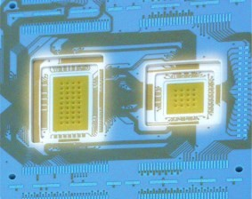
Integration Levels
SSI Small scale integration
MSI Medium scale integration
LSI Large scale integration
VLSI Very large scale integration
ULSI Ultra large scale integration
12 gates/chip
100 gates/chip 1K gates/chip 10K gates/chip 100K gates/chip
5

Slide 5
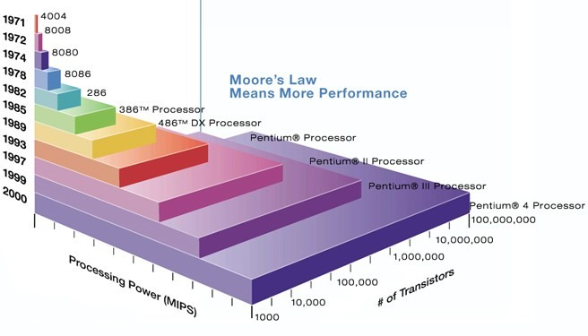
Moore’s law
A prediction made by Moore (a co-founder of Intel) in 1965: “… a number of transistors to double every 2 years.”
6

Slide 6

Logic Families
Logic families are sets of chips that may implement different logical functions, but use the same type of transistors and voltage levels for logical levels and for the power supplies.
These families vary by speed, power consumption, cost,
voltage & current levels
IC digital logic families
DL
DTL
RTL
TTL
ECL
MOS
CMOS
(Diode- logic)
（Diode-transistor logic）
（Resistor-transistor logic）
（Transistor -transistor logic）
（Emitter-coupled logic）
（Metal-oxide semiconductor）
(Complementary Metal-oxide semiconductor）

Slide 7



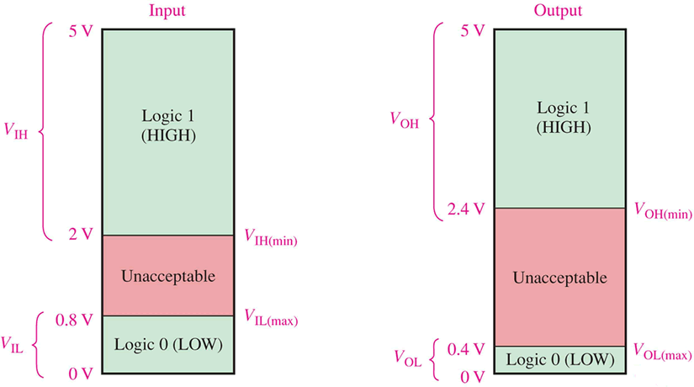


Digital IC Terminology
Voltage Parameters:
V_{IH}(min): high-level input voltage, the minimum voltage level required for a logic 1 at an input.
V_{IL}(max): low-level input voltage
V_{OH}(min): high-level output voltage
V_{OL}(max): low-level output voltage
For proper operation the input voltage levels to a logic must be kept
outside the indeterminate range.
Lower than V_{IL}(max) and higher than V_{IH}(min).
For TTL

Slide 8
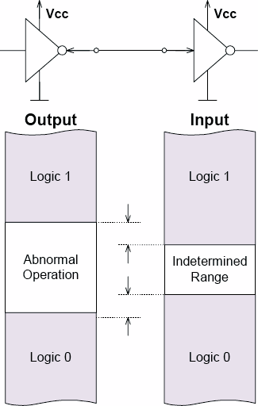
Digital IC Terminology
Noise Margin
noise is present in all real systems
this adds random fluctuations to
voltages representing logic levels
to cope with noise, the voltage ranges defining the logic levels are more tightly constrained at the output of a gate than at the input
thus small amounts of noise will not
affect the circuit
the maximum noise voltage that can be tolerated by a circuit is termed its noise immunity (noise Margin)
^{V}NH
^{V}NL
VNH = VOH(min) − VIH(min) VNL = VIL(max) − VOL(max)

Slide 9
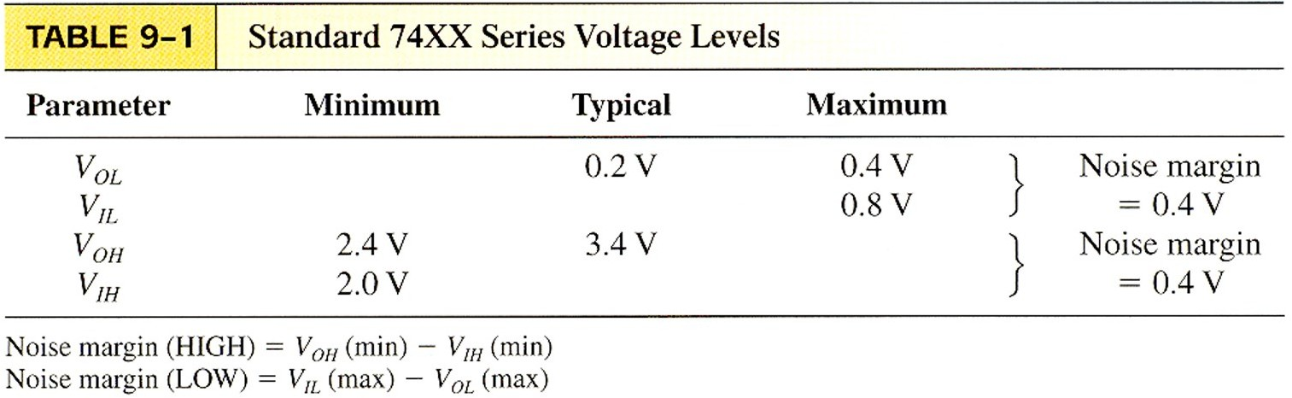
Digital IC Terminology
Noise Margin

Slide 10
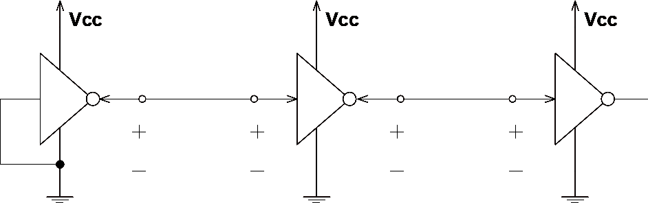
Digital IC Terminology
Current Parameters:
I_{OH} – Current flowing into an output in the logical “1” state under specified load
conditions
I_{OL} – Current flowing into an output in the logical “0” state under specified load
conditions
I_{IH} – Current flowing into an input when a specified HI level is applied to that
input
I_{IL} – Current flowing into an input when a specified LO level is applied to that
input
^{I}OH
^{I}IH
^{I}OL
^{I}IL
^{V}OH
^{V}IH
^{V}OL
^{V}IL
11

Slide 11
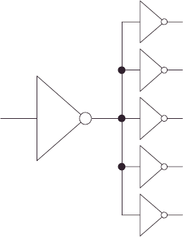
fanout
Digital IC Terminology
The maximum number of standard logic inputs that an output can
drive reliably.
Also known as the loading factor.
Related to the current parameters (both in high and low states.)
DC fanout = min( ^{IOH}
, ^{I}OL
)
^{I} IH ^{I} IL
12

Slide 12
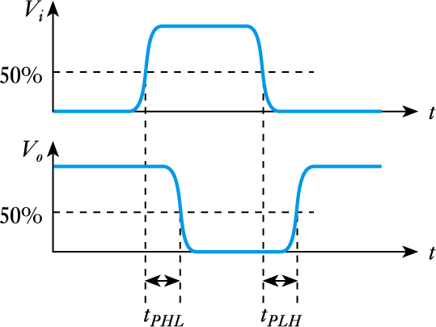
Digital IC Terminology
Timing considerations
all gates have a certain propagation delay time, t_{PD}
this is the average of the two switching times
^{t}PD ^{= 1 (t}PHL ^{+ t}PLH ⁾
2

Slide 13
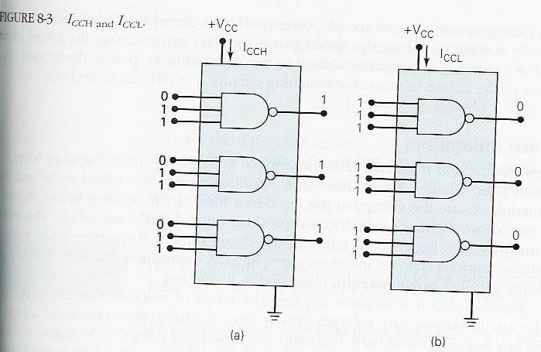
Digital IC Terminology
Power Requirements
Every IC needs a certain amount of electrical power to operate.
V_{cc} (TTL)
V_{DD}(MOS)
Power dissipation determined by I_{cc} and V_{cc}.
Average I_{cc}(avg)= (I_{CCH} + I_{CCL})/2
P_{D}(avg) = I_{cc}(avg) x V_{cc}

Slide 14
Speed-Power Product
Digital IC Terminology
Desirable properties:
Short propagation delays (high speed)
Low power dissipation
Speed-power product measures the combined effect.

Slide 15
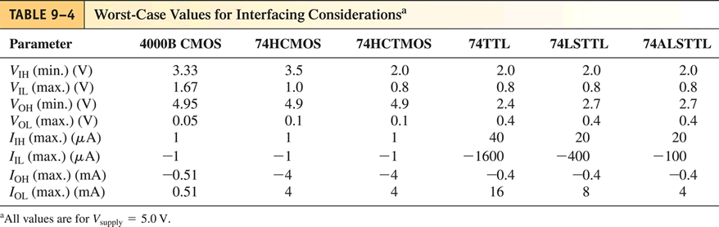
Interfacing Logic Families
We’ve seen that different logic families have different voltage and current specifications.
These differences can cause problems when you connect a
gate from one family to a gate from another family.

Slide 16
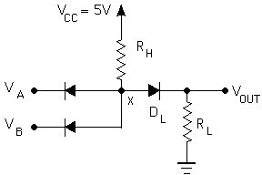

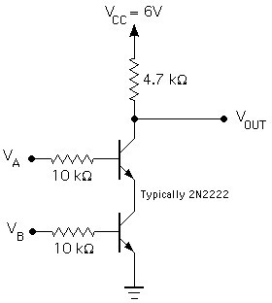

Notes about Families
Diode Logic (DL)
simplest; does not scale
NOT not possible (need an active element)
=
Resistor-Transistor Logic (RTL)
replace diode switch with a transistor switch
can be cascaded
large power draw
=
19

Slide 17
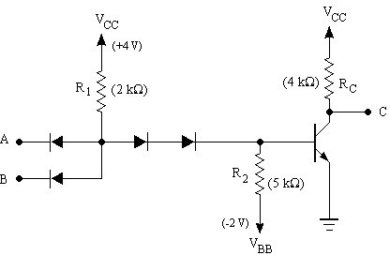
Then
Diode-Transistor Logic (DTL)
essentially diode logic with transistor amplification
reduced power consumption
faster than RTL
=
DL AND gate
Saturating inverter
20

Slide 18
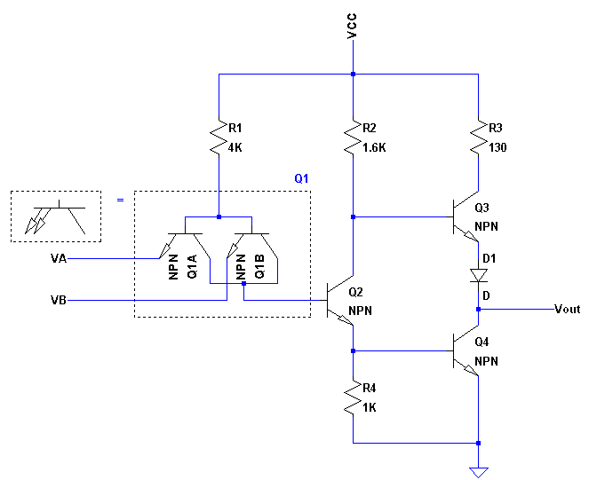
TTL Logic Families
TTL: Transistor-Transistor Logic
first introduced by in 1964 (Texas Instruments)
TTL has shaped digital technology in many ways
one of the most widely used families for small- and medium-scale
devices – rarely used for VLSI
Standard TTL family (e.g. 7400) is obsolete
Newer TTL families still used (e.g. 74ALS00)
High energy consumption, but
relatively insensitive to electrostatic discharge (ESD)
Distinct features: (Multi-emitter transistors - Totem-pole output)

Slide 19
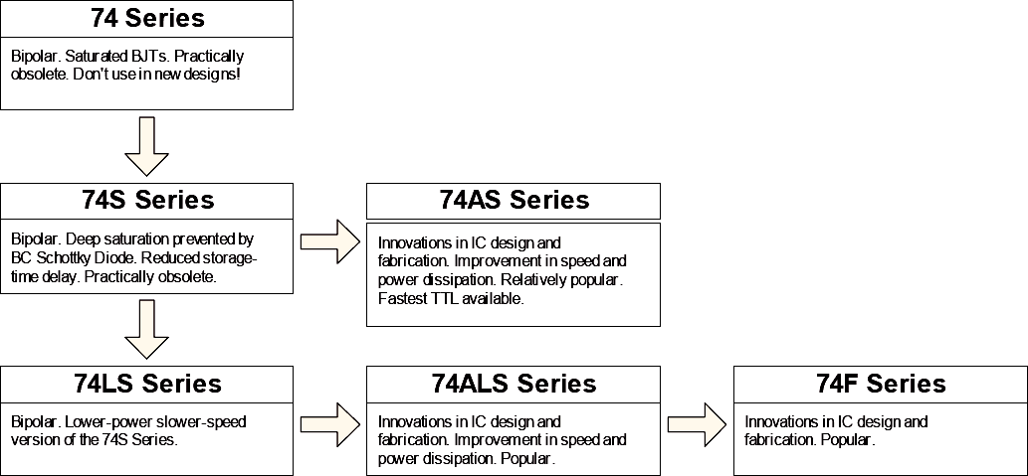
TTL family evolution
Legacy: don’t use in new designs
Widely used today
22

Slide 20
ECL
Emitter-Coupled Logic (ECL)
based on BJT, but removes problems of delay time by preventing the transistors from saturating
very fast operation - propagation delays of 1ns or less
high power consumption, perhaps 60 mW/gate
Logic levels. “0”: –1.7V. “1”: –0.8V
Such strange logic levels require extra effort when interfacing to TTL/CMOS logic families.
low noise immunity of about 0.2-0.25 V
used in some high speed specialist applications, but now largely
replaced by high speed CMOS
23

Slide 21
CMOS Complimentary MOS (CMOS)
Considerably lower energy consumption than TTL and ECL, which
has made portable electronics possible.
most widely used family for large-scale devices
combines high speed with low power consumption
usually operates from a single supply of 5 – 15 V
excellent noise immunity of about 30% of supply voltage
can be connected to a large number of gates (about 50)
Things to watch out for:
don’t leave inputs floating (in TTL these will float to HI, in CMOS you get undefined behaviour)
susceptible to electrostatic damage (finger of death)
24

Slide 22

CMOS/TTL power requirements
TTL power essentially constant (no frequency dependence)
CMOS power scales as ∝ f × C × V²
frequency
supply volt. eff. capacitance
At high frequencies (>> MHz) CMOS dissipates more power than TTL
Overall advantage is still for CMOS even for very fast chips – only a relatively small portion of complicated circuitry operates at highest frequencies
25

Slide 23
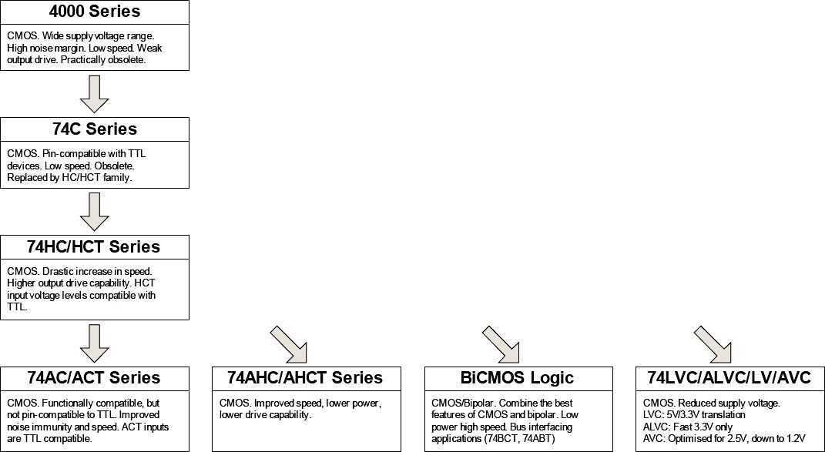
CMOS family evolution
obsolete
Power reduction is one of the keys to progressive growth of integration
26

Slide 24
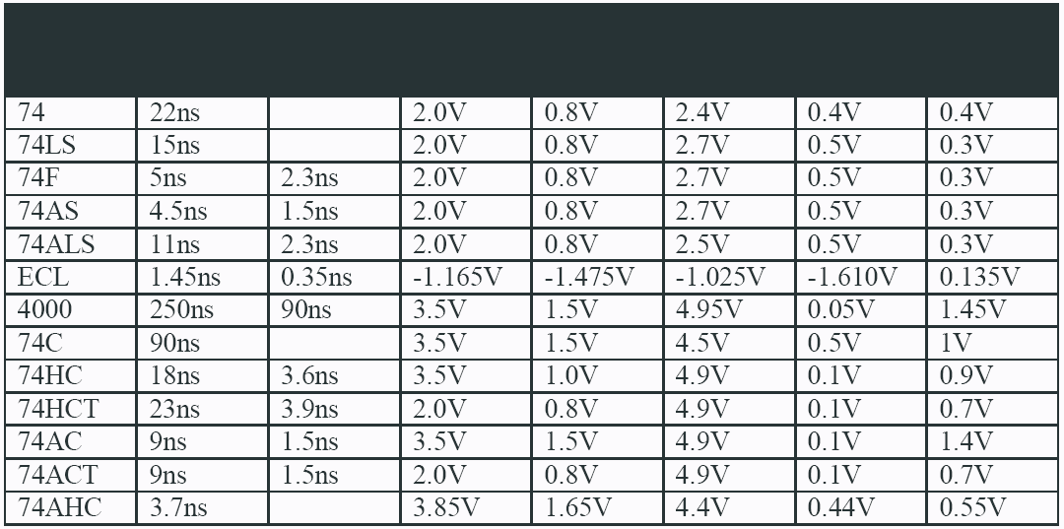
Overview
TTL
Logic
Family
Noise
Margin
^{T}PD ^{T}rise/fall
^{V}IH,min ^{V}IL,max
^{V}OH,min
^{V}OL,max
Values typical for V_{cc}/V_{dd} = 5V
When interfacing different families, pay attention
CMOS
to their input/output voltage, current (fanout)
27

Slide 25
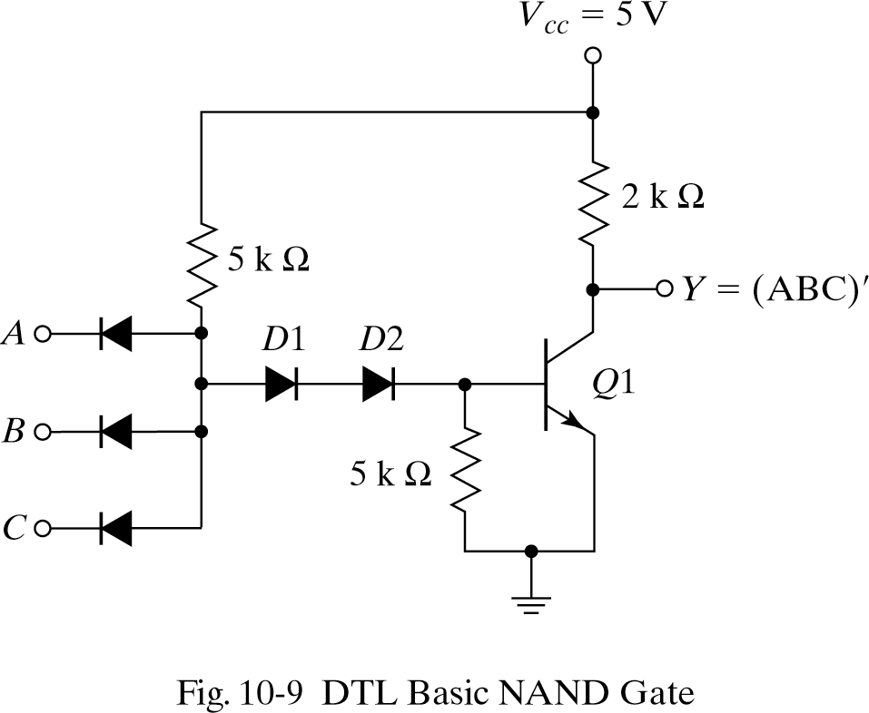
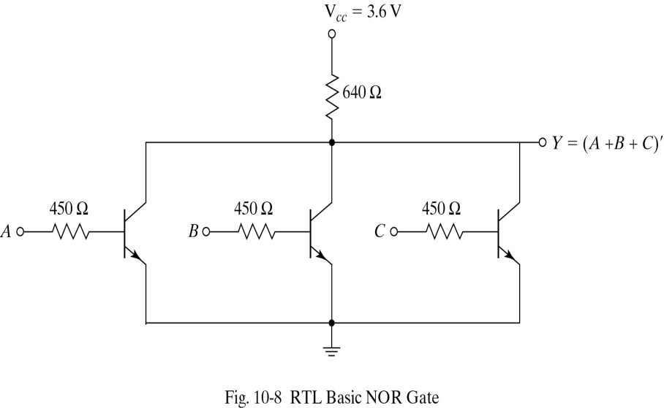
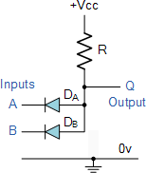
Some Gates
2-input AND Gate Diode-Resistor Logic

Slide 26
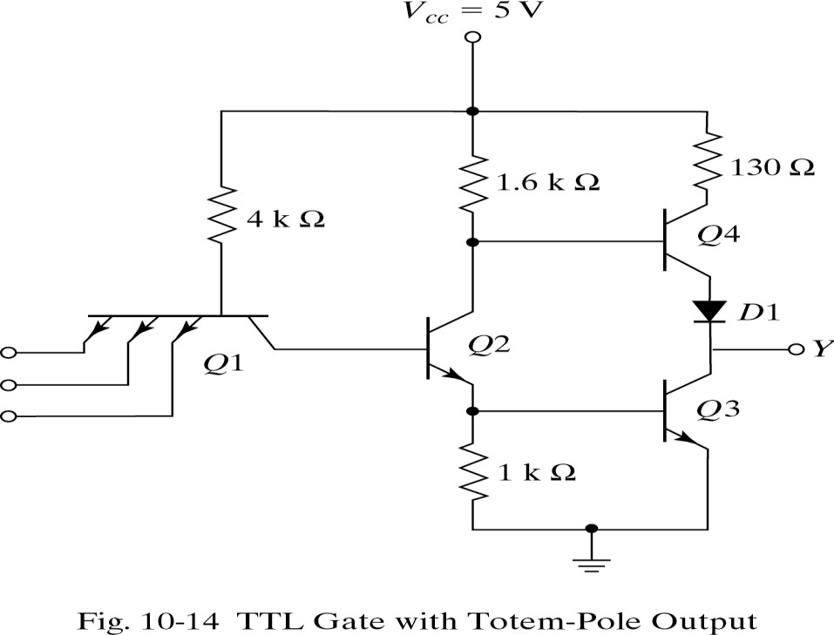
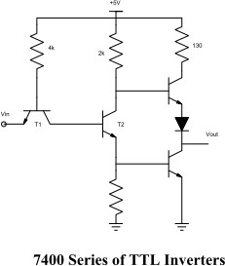
Some Gates

Slide 27
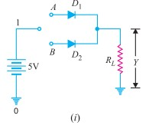
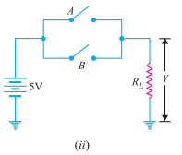


Diode-Resistor OR gate

Slide 28
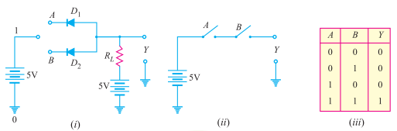
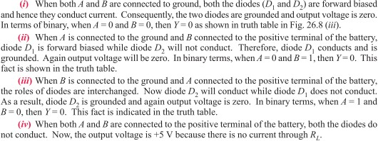
Diode-Resistor AND gate

Slide 29
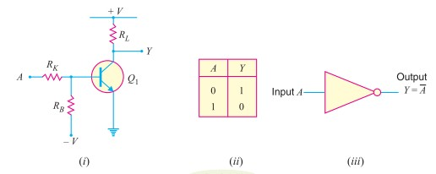

NOT gate

Slide 30
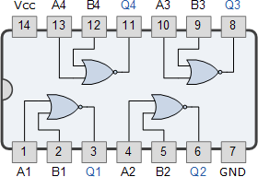
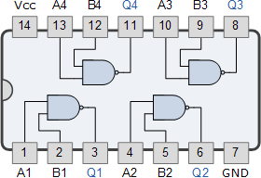
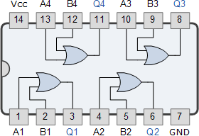
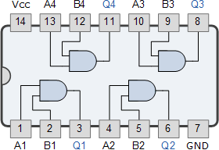
Common ICs
7402 Quad 2-input NOR Gate
7400 Quad 2-input Logic NAND Gate
Also:
74LS00 Quad 2-input 74LS10 Triple 3-input 74LS20 Dual 4-input 74LS30 Single 8-input
7432 Quad 2-input Logic OR Gate
7408 Quad 2-input AND Gate

Slide 31
